Slide 1

Inline 3D Scanning Prototype System for Industrial Part Inspection with 2D Camera and Line Laser
Handong Global University
School of Mechanical & Control Engineering
Dec.20.2024
24-2 MIP
21800226 Yunki Noh
Supervisor. Young-Keun Kim
Notes:
Hello, my name is yunki noh. I have performed the research for building up 3D scanning system based on the laser triangulation method with 2D camera under the guidance of Young-Keun Kim professor.

Slide 2
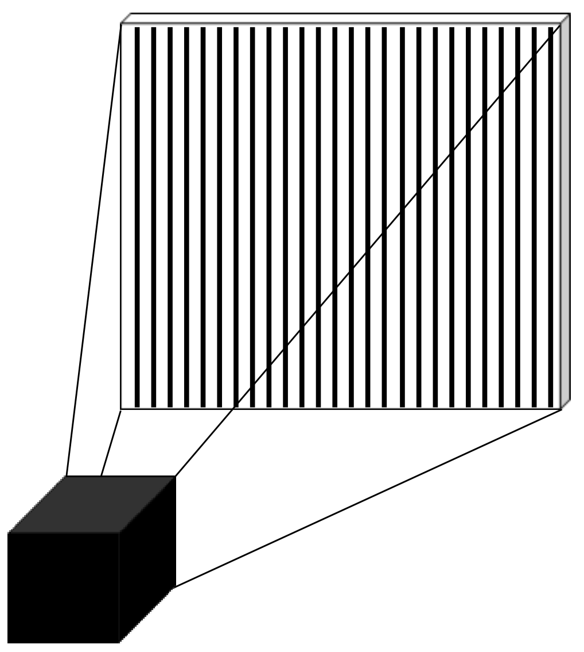
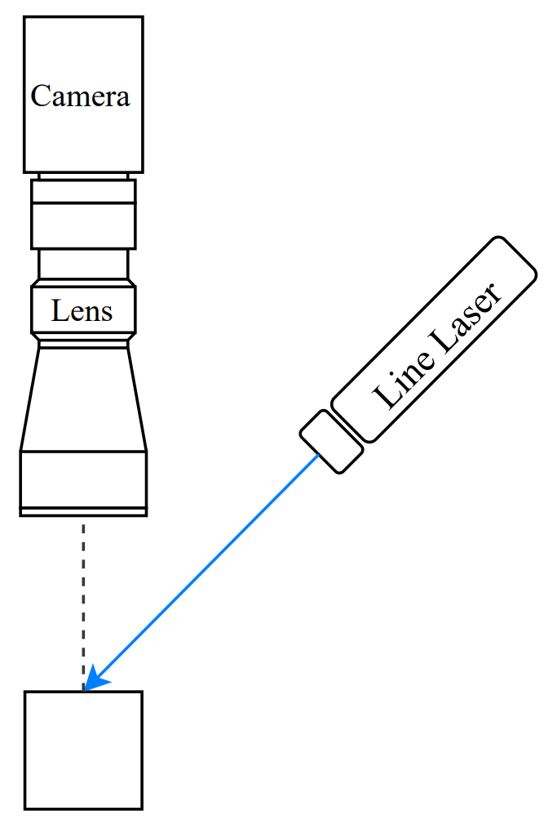
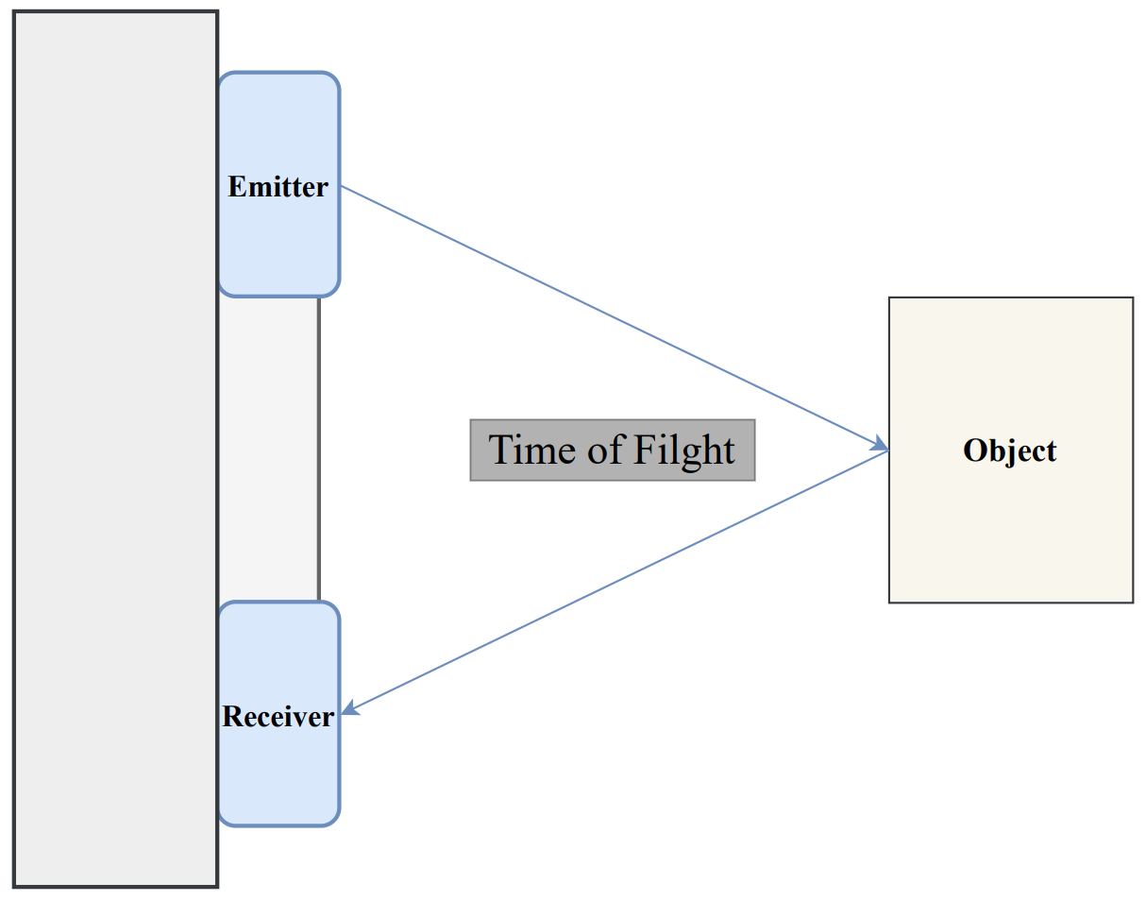
1. Background: Optical 3D Scanning Methods
24-2 MIP Video Clip
3D Camera VS 2D Camera
ToF (Time of Flight)
Laser Triangulation
Structured Light
- Using Time of Flight
- Lower Precision
- Out Door Scanning
- Using Displacement of Laser
- The Most Precision (micrometer)
- Inspection for Small Industrial Part
- Using Structured Light
- Middle Precision
- VR, Automatic Driving etc.
Start
End
Notes:
There are already several types of 3D scanning methods.
However, the optical 3D scanning system can provide most precise 3D scanning result comparing with other methods. There are three types of optical 3D scanning methods. Each of them have been used for different purposes.
Among these method, the laser triangulation method has been used to inspect defect of industrial small part. Especially, 3D camera is almost used for 3D scanning of the laser triangulation.
In fact, this type of 3D camera is expensive. For this reason, it is not easy to use these 3D cameras for non-industrial purposes. However, the laser triangulation method does not need complicated way to get height information. If there are some optical equipment, this method can be realized: high resolution of 2D camera, Telecentric lens, and fine line laser. In fact, these devices are basic equipment for the university's machine vision laboratory. In addition to this, these things are cheaper than 3D camera. For this reason, I decided to build up 3D scanning system for the laser triangulation based on the 2D camera. If the 3D scanning system can be performed with 2D camera, study for 3D scanning would be performed in the scale of the university.

Slide 3
1. Background: Optical 3D Scanning Methods
24-2 MIP Video Clip
3D Camera VS 2D Camera
ToF (Time of Flight)
Laser Triangulation
Structured Light
- Using Time of Flight
- Lower Precision
- Out Door Scanning
- Using Displacement of Laser
- The Most Precision (micrometer)
- Inspection for Small Industrial Part
- Using Structured Light
- Middle Precision
- VR, Automatic Driving etc.
2D machine vision camera can be used
for defect inspection of small industrial components.
Start
End
Notes:
There are already several types of 3D scanning methods.
However, the optical 3D scanning system can provide most precise 3D scanning result comparing with other methods. There are three types of optical 3D scanning methods. Each of them have been used for different purposes.
Among these method, the laser triangulation method has been used to inspect defect of industrial small part. Especially, 3D camera is almost used for 3D scanning of the laser triangulation.
In fact, this type of 3D camera is expensive. For this reason, it is not easy to use these 3D cameras for non-industrial purposes. However, the laser triangulation method does not need complicated way to get height information. If there are some optical equipment, this method can be realized: high resolution of 2D camera, Telecentric lens, and fine line laser. In fact, these devices are basic equipment for the university's machine vision laboratory. In addition to this, these things are cheaper than 3D camera. For this reason, I decided to build up 3D scanning system for the laser triangulation based on the 2D camera. If the 3D scanning system can be performed with 2D camera, study for 3D scanning would be performed in the scale of the university.

Slide 4
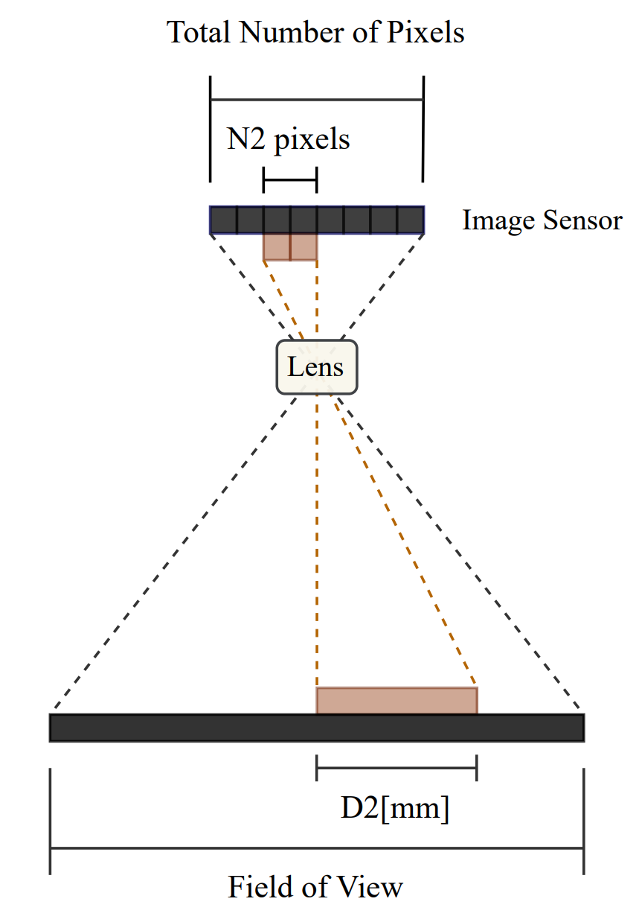
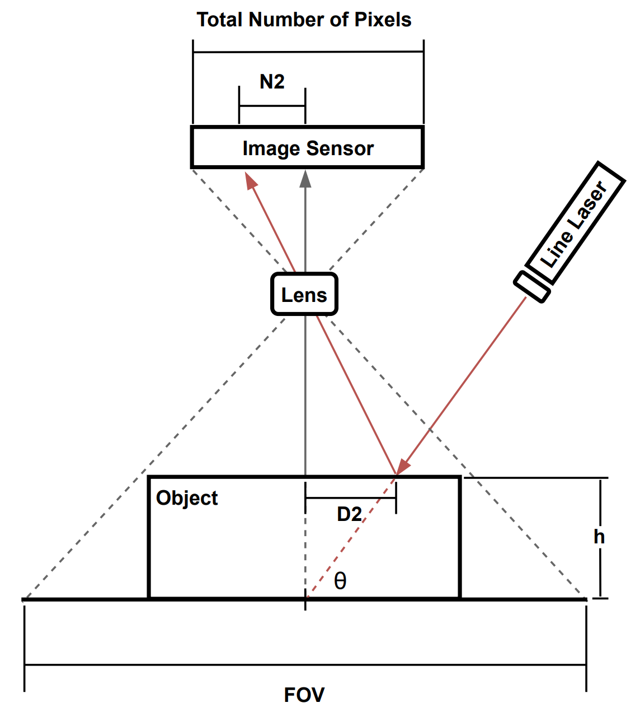
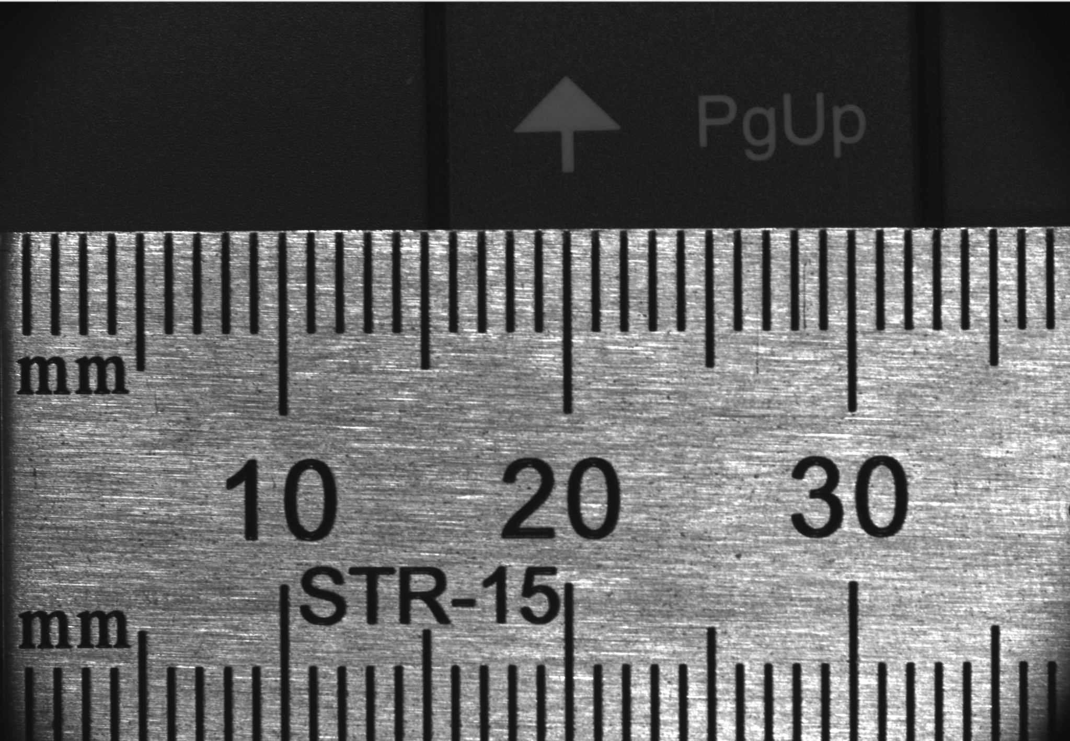

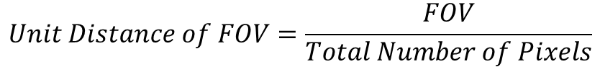
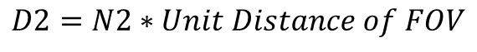
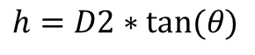
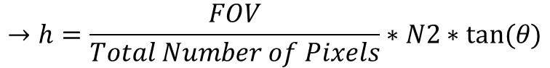
2. Method Description: Laser Triangulation
24-2 MIP Video Clip
$$Unit Distance of FOV=\frac{FOV}{Total Number of Pixels}$$
$$D2=N2∗Unit Distance of FOV$$
$$h=D2∗tan⁡(θ)$$
$$→h=\frac{FOV}{Total Number of Pixels}∗N2∗tan⁡(θ)$$
$$FOV\left(Field of View\right):The whole range of view which camera can capture$$
$$Unit Distance of FOV:Unit Distance which each pixel of image sensor performs about FOV$$
Image captured by 2D camera
Notes:
This method is based on the triangulation method. By using the triangulation method, the length of one side of a triangle can be calculated with the other two sides and the angle of intersection. To obtain 3D scanning result of an object, height values need to be calculated by using this method with line laser.
And the 3D scanning method combined with triangulation and line laser is called as laser triangulation method. With this method, height values of a small object can be calculated with a 2D camera and line laser. As looking at the left side of the figure, the laser is projected onto a predetermined parallel line in the camera's image. When an object is below the laser, this object displaces the laser by a distance D2. The height is then calculated by multiplying D2 with tan(θ).
Like this, to get height values, the real distances needs to be obtained per each image. At this point, the real distance can be obtained by multiplying the number of pixels of D2 with unit distance of FOV. FOV means the full range of image which the camera would be able to capture.
In other words, to calculate each height value, only number of the D2 would be necessary. The other values are already produced at the initial setting of this system.
From this processes, this system would be able to calculate real distances and height values.

Slide 5
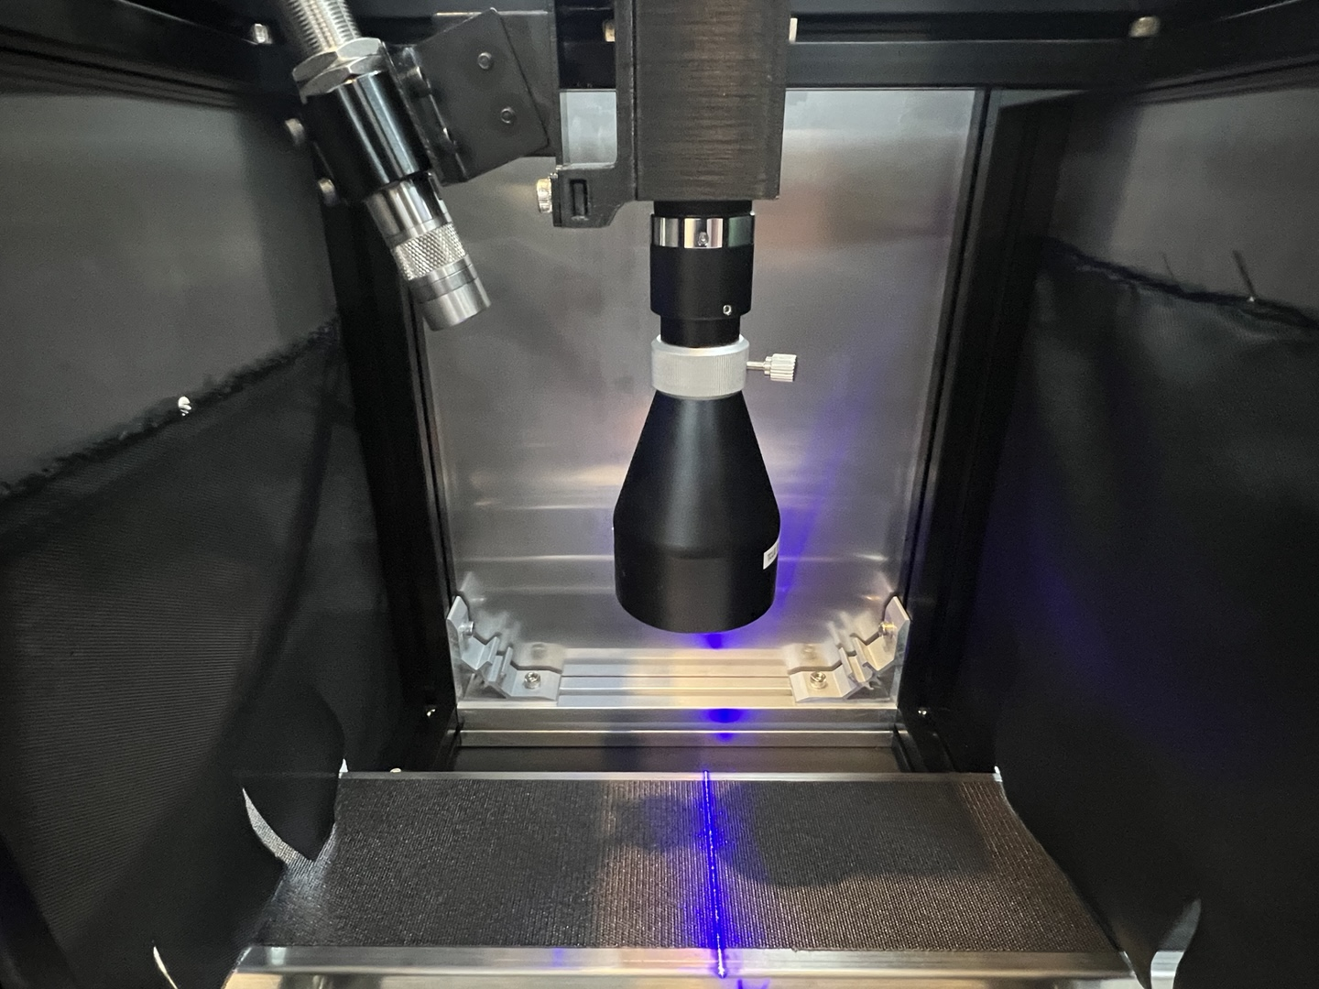
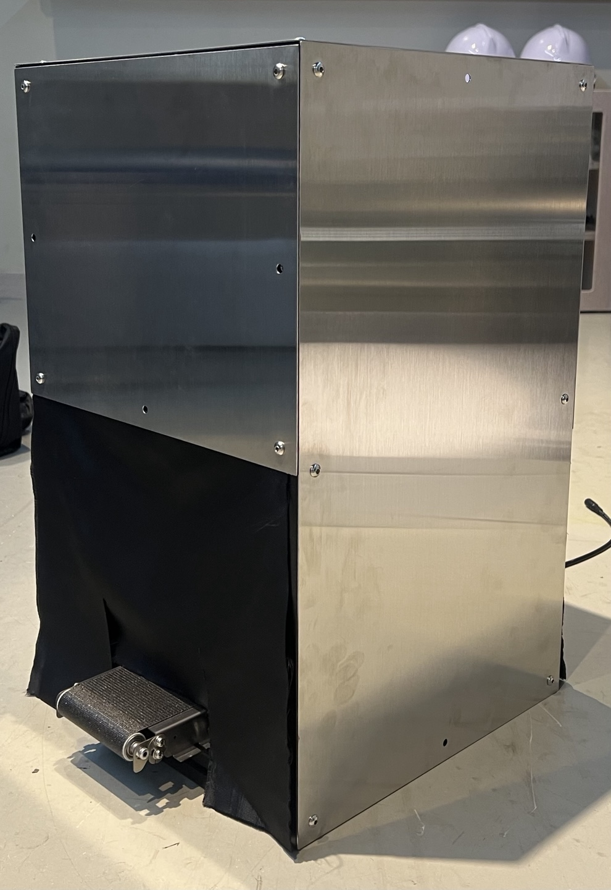
3. Hardware: Overview
24-2 MIP Video Clip
2D Camera
Blocking Light
Line Laser
Telecentric Lens
Conveyor Belt
Internal
External
Notes:
To build up fundamental environment for 3D scanning using laser triangulation, I fixed the position of 2D Camera, Telecentric Lens, Line Laser, and Conveyor Belt.
In addition to this, to block the light disturbance, I covered five sides of the hardware system.

Slide 6
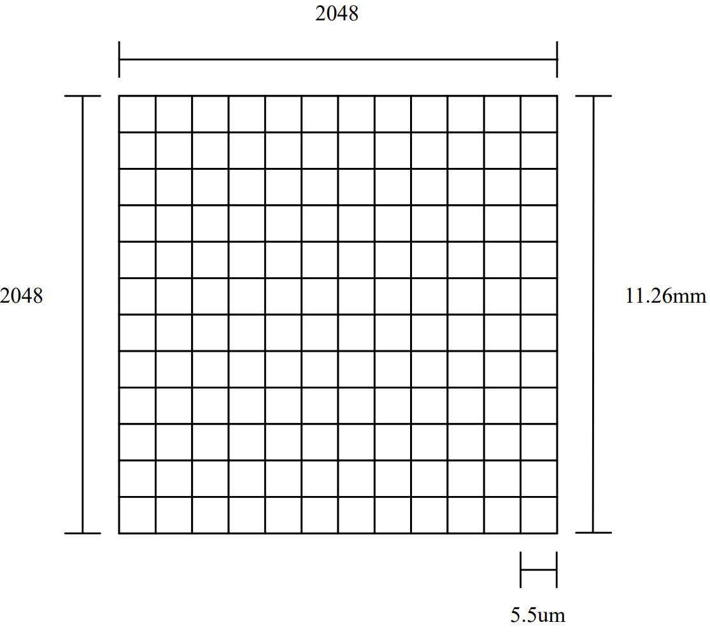
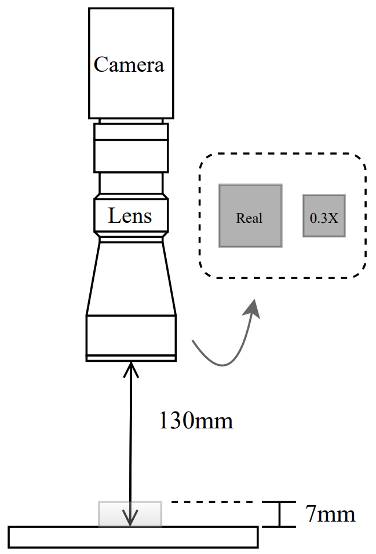
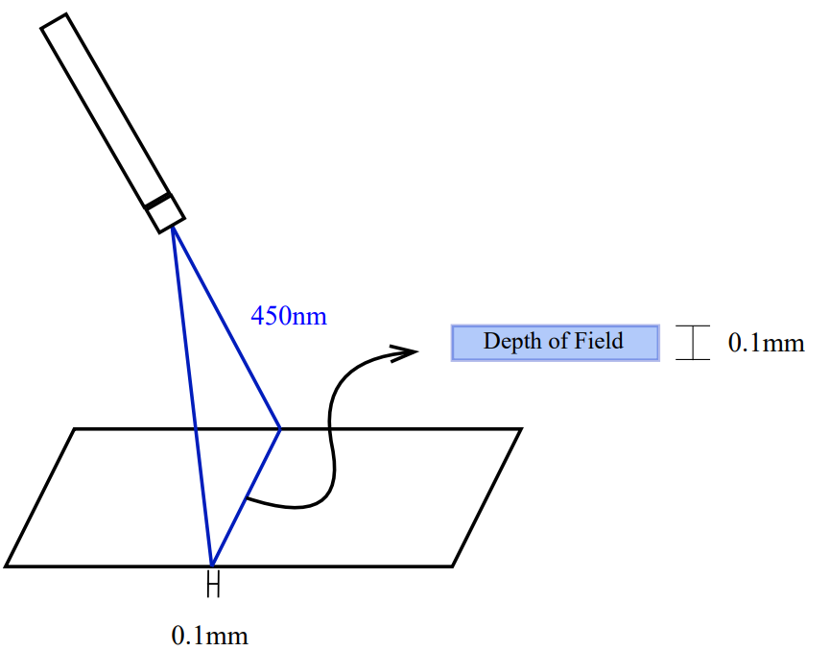
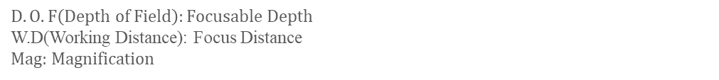
3. Hardware: Camera, Lens, Laser
24-2 MIP Video Clip
2D Machine Vision Camera
Telecentric Lens
Line Laser
GS3-U3-41C6NIR-C
TCL0.3X-130I-HR
ZX20
-Resolution: 2048x2048
-Pixel size: 5.5 µm x 5.5 µm
-Image sensor size: 11.26 mm x 11.26 mm
- W.D(mm): 130
- D.O.F(mm): 7
- Mag: 0.3X
- Wavelength: 450nm
- Line width: 0.1mm(350mm)
- DOF: 0.1mm(400mm)
$$D.O.F\left(Depth of Field\right):Focusable Depth$$
W.D(Working Distance): Focus Distance
Mag: Magnification
Notes:
I chose the 2D machine vision camera based on the specification of 3D camera for laser triangulation. The resolution of this camera is 2048x2048. And pixel size is micrometer scale.
To prevent the perspective distortion, I decided to use telecentric lens. Because the magnification of this lens is 0.3, the Filed of View would be 37.53mm x 37.53mm. In addition to this, this lens can focus up to 7mm from the focal length. The focal length of this lens is 130mm from the object.
To obtain precise result of 3D scanning, the line laser needs to be thinner than 1mm. This laser can provide 0.1mm at the distance of 350mm.

Slide 7
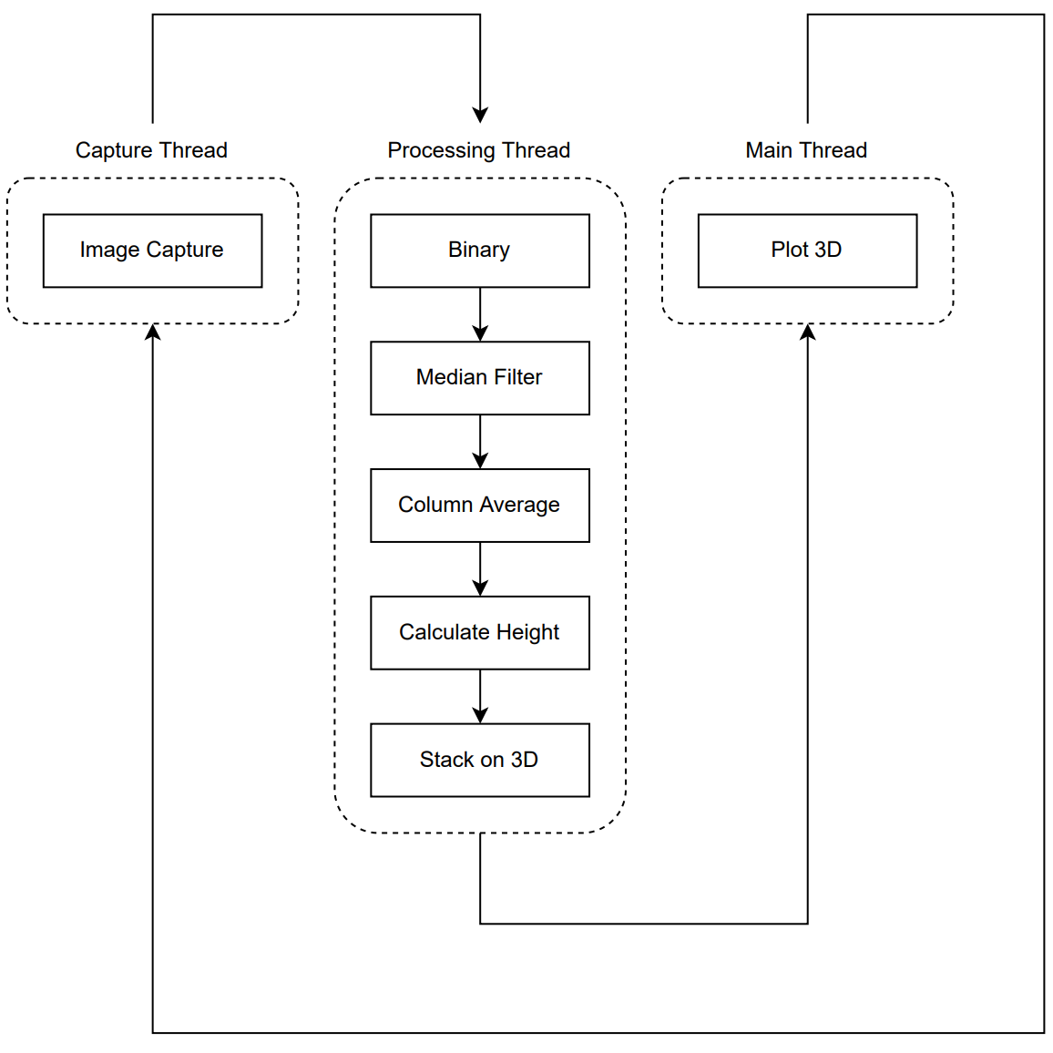
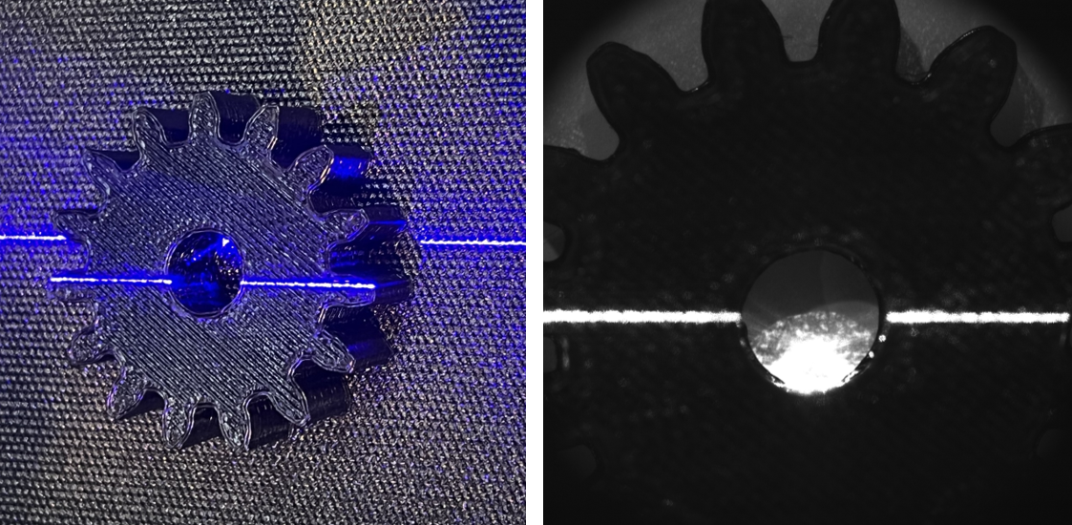
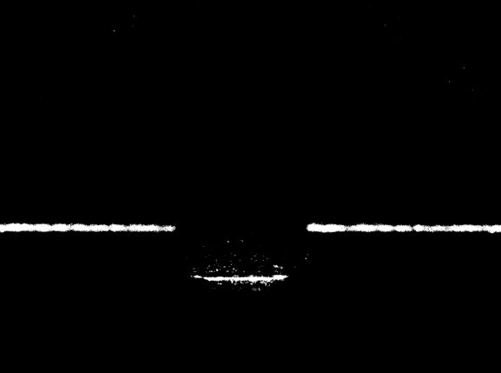
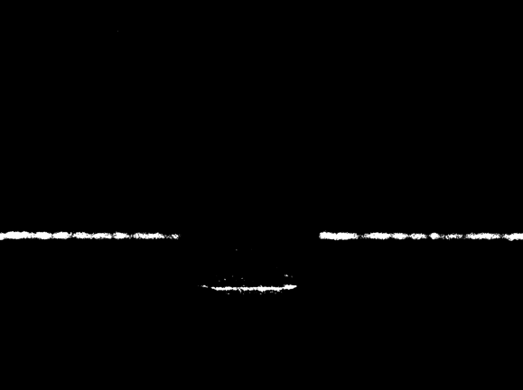

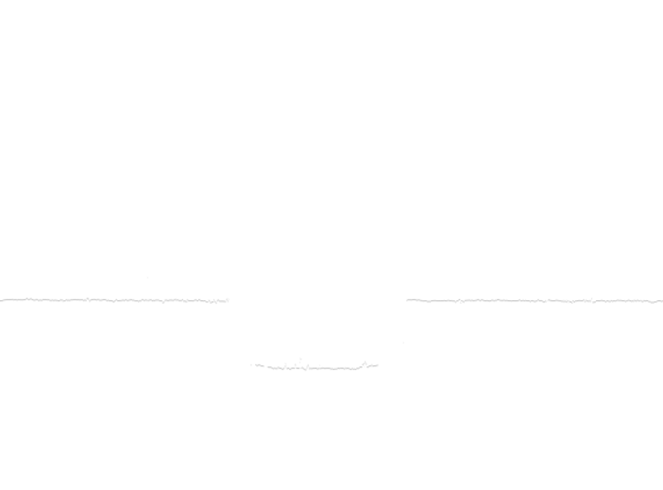
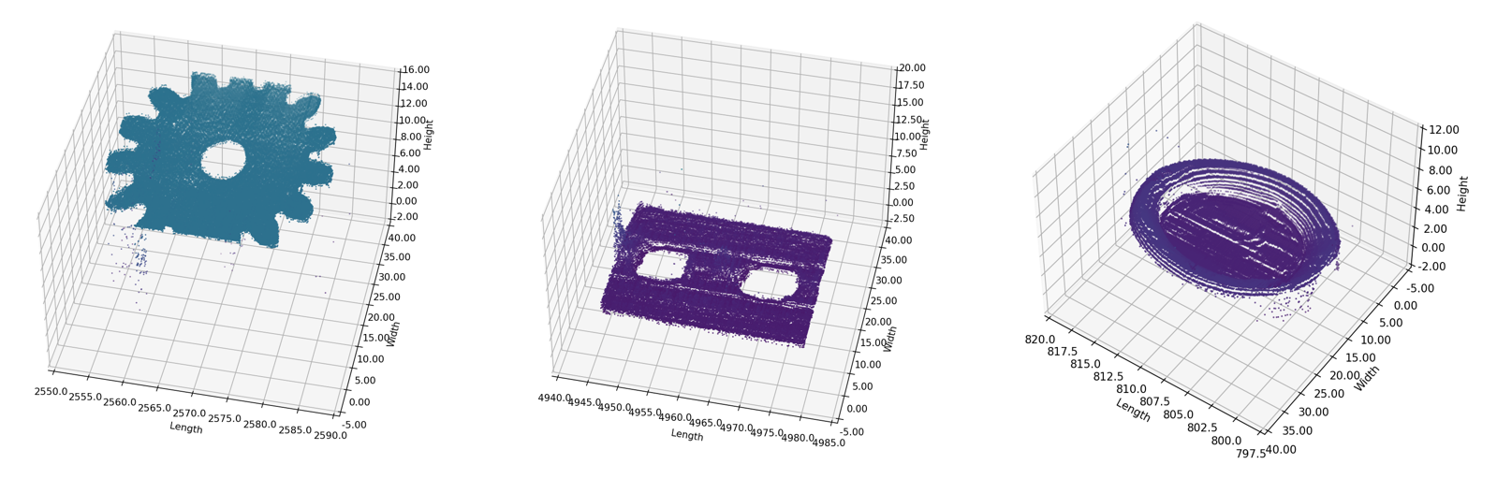
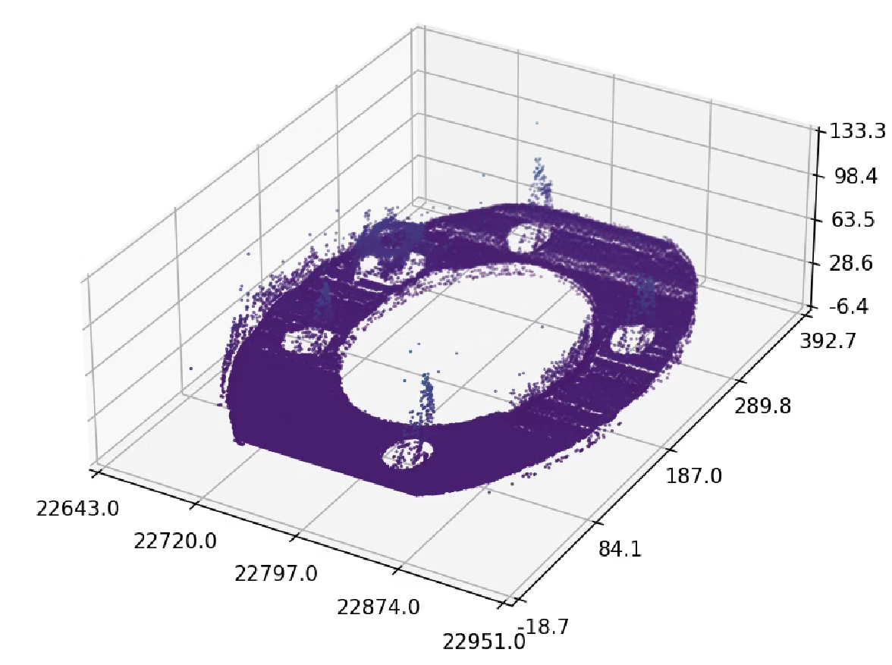
4. Software: Overview
24-2 MIP Video Clip
1.Image Capture
2.Image Processing
3.Plot 3D
Notes:
To obtain 3D scanning result in this hardware environment, I developed software system in the python environment.
The software system can be divided into three steps: Image capture, Image processing, and 3D plotting.
To capture each image at the speed of fps without delay, this process is performed at the separate parallel thread.
After source image is captured as color image, this image would be converted into binary scale to deal with the points of the line laser. In addition to this, to focus on only the line laser, I decided to pass points over 250 value of brightness.
Even the other light would be removed from this image, the optical noises from the scattering of the line laser need to be removed. To remove these noises, the median filter was used.
After extracting the light of the line laser, the points of line laser would be averaged to calculated height value.
With the fine line each 2D image would be obtained, and by stacking these images on the x axis, the 3D scanning result would be performed.

Slide 8
Overall Results of 3D Scanning
Notes:
The ultimate purpose of this project is to inspect the defect of small industrial parts. With the 3D scanning result from this system, a gear and frame was used to check the performance of detecting defect by using this system.
As you can see, each normal state of gear and frame were able to be scanned well. About the flat surfaces, this system can scan the overall shape of each parts. However, hidden sides of each objects were not scanned well, leaving the white space of 3D scanning. This limitation is the fundamental problem of the line triangulation system. Because the light is in a straight way, there must be white space of scanning.
Despite of this, the defects of each parts on the flat surfaces were scanned well. In the case of the gear, two defect were marked at on the flat surface, and these defects are reflected on the result of the 3D scanning. At the same time, the defect marked on the surface of the frame is also reflected well at the 3D scanning result.
By using this result, I could check the possibility of this system for the defect inspection about industrial small parts.

Slide 9
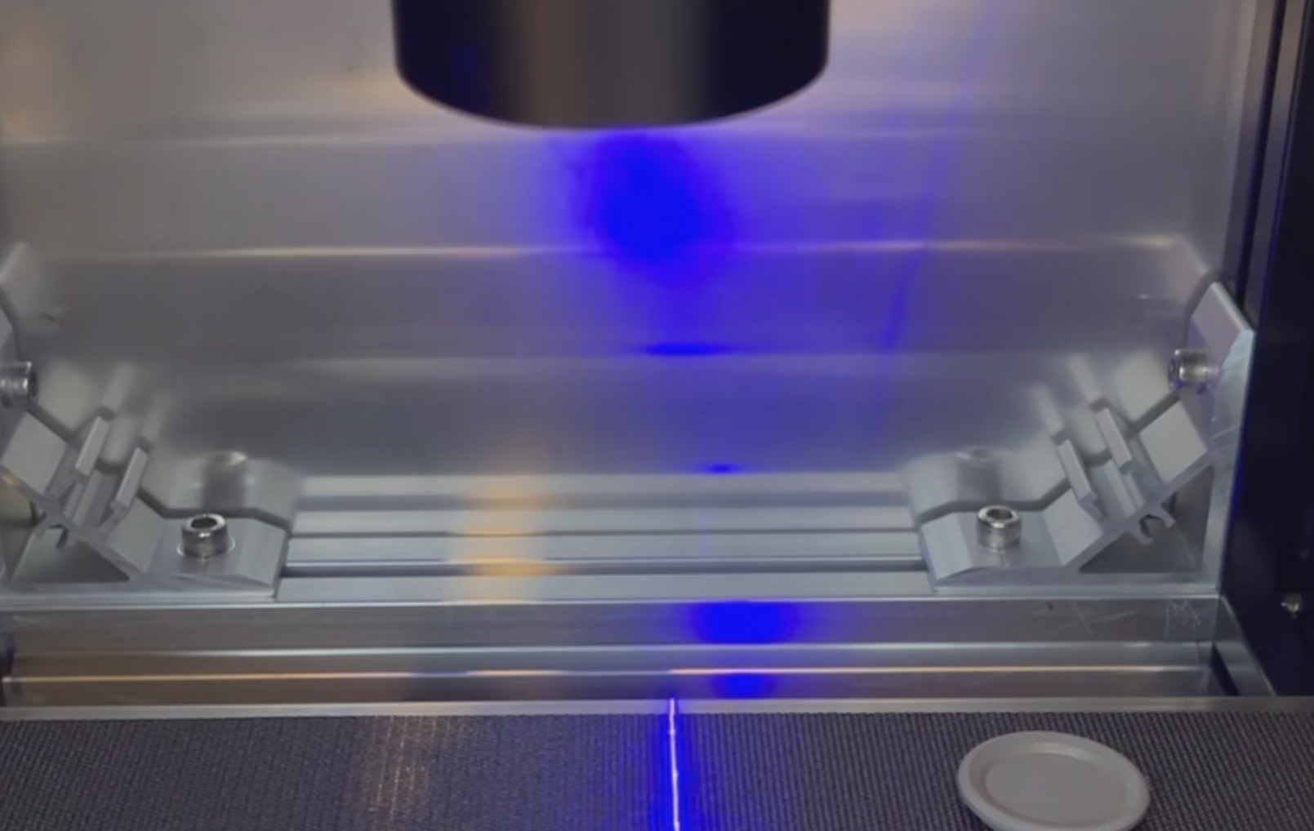
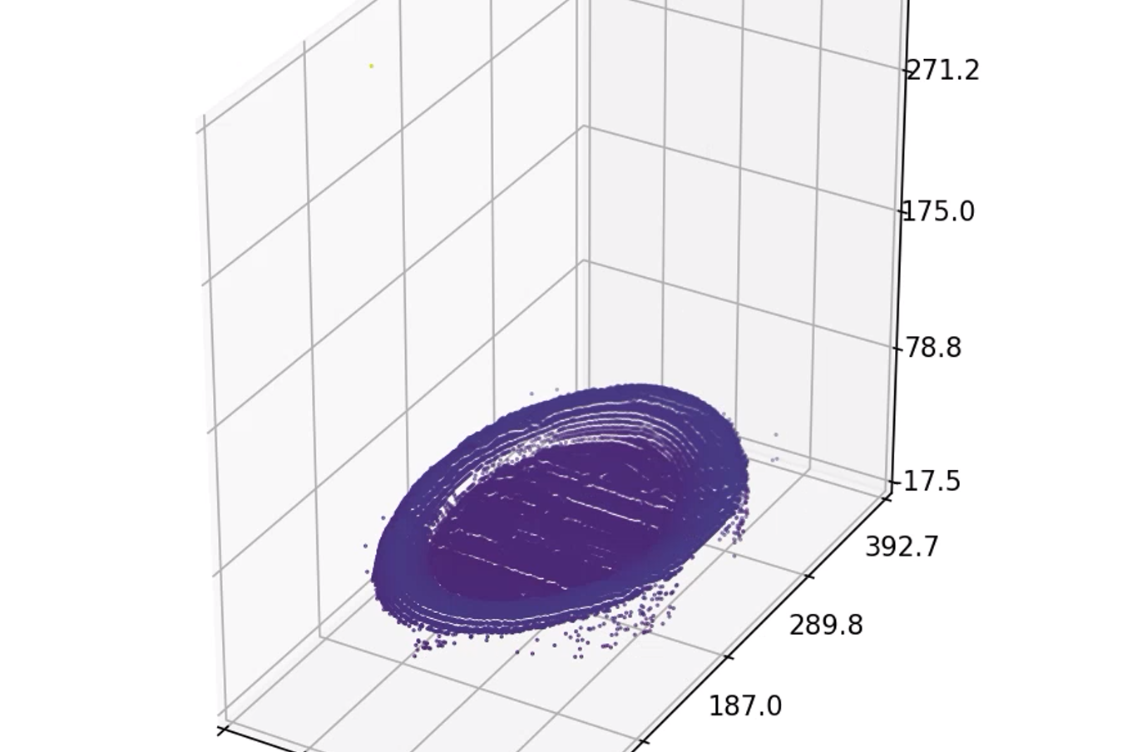
5. Result: Cap
24-2 MIP Video Clip
핸드폰
뚜껑.mp4
노트북
뚜껑.mp4
Notes:
The ultimate purpose of this project is to inspect the defect of small industrial parts. With the 3D scanning result from this system, a gear and frame was used to check the performance of detecting defect by using this system.
As you can see, each normal state of gear and frame were able to be scanned well. About the flat surfaces, this system can scan the overall shape of each parts. However, hidden sides of each objects were not scanned well, leaving the white space of 3D scanning. This limitation is the fundamental problem of the line triangulation system. Because the light is in a straight way, there must be white space of scanning.
Despite of this, the defects of each parts on the flat surfaces were scanned well. In the case of the gear, two defect were marked at on the flat surface, and these defects are reflected on the result of the 3D scanning. At the same time, the defect marked on the surface of the frame is also reflected well at the 3D scanning result.
By using this result, I could check the possibility of this system for the defect inspection about industrial small parts.

Slide 10
5. Result: Flat Joint
24-2 MIP Video Clip
핸드폰
연결장치.mp4
노트북
연결장치.mp4
Notes:
The ultimate purpose of this project is to inspect the defect of small industrial parts. With the 3D scanning result from this system, a gear and frame was used to check the performance of detecting defect by using this system.
As you can see, each normal state of gear and frame were able to be scanned well. About the flat surfaces, this system can scan the overall shape of each parts. However, hidden sides of each objects were not scanned well, leaving the white space of 3D scanning. This limitation is the fundamental problem of the line triangulation system. Because the light is in a straight way, there must be white space of scanning.
Despite of this, the defects of each parts on the flat surfaces were scanned well. In the case of the gear, two defect were marked at on the flat surface, and these defects are reflected on the result of the 3D scanning. At the same time, the defect marked on the surface of the frame is also reflected well at the 3D scanning result.
By using this result, I could check the possibility of this system for the defect inspection about industrial small parts.

Slide 11
5. Result : Circle Joint
24-2 MIP Video Clip
핸드폰
원.mp4
노트북
원.mp4
Notes:
The ultimate purpose of this project is to inspect the defect of small industrial parts. With the 3D scanning result from this system, a gear and frame was used to check the performance of detecting defect by using this system.
As you can see, each normal state of gear and frame were able to be scanned well. About the flat surfaces, this system can scan the overall shape of each parts. However, hidden sides of each objects were not scanned well, leaving the white space of 3D scanning. This limitation is the fundamental problem of the line triangulation system. Because the light is in a straight way, there must be white space of scanning.
Despite of this, the defects of each parts on the flat surfaces were scanned well. In the case of the gear, two defect were marked at on the flat surface, and these defects are reflected on the result of the 3D scanning. At the same time, the defect marked on the surface of the frame is also reflected well at the 3D scanning result.
By using this result, I could check the possibility of this system for the defect inspection about industrial small parts.

Slide 12
5. Result : Cube Obstacle
24-2 MIP Video Clip
핸드폰
큐브.mp4
노트북
큐브.mp4
Notes:
The ultimate purpose of this project is to inspect the defect of small industrial parts. With the 3D scanning result from this system, a gear and frame was used to check the performance of detecting defect by using this system.
As you can see, each normal state of gear and frame were able to be scanned well. About the flat surfaces, this system can scan the overall shape of each parts. However, hidden sides of each objects were not scanned well, leaving the white space of 3D scanning. This limitation is the fundamental problem of the line triangulation system. Because the light is in a straight way, there must be white space of scanning.
Despite of this, the defects of each parts on the flat surfaces were scanned well. In the case of the gear, two defect were marked at on the flat surface, and these defects are reflected on the result of the 3D scanning. At the same time, the defect marked on the surface of the frame is also reflected well at the 3D scanning result.
By using this result, I could check the possibility of this system for the defect inspection about industrial small parts.

Slide 13
Results of Defect Inspection
Notes:
The ultimate purpose of this project is to inspect the defect of small industrial parts. With the 3D scanning result from this system, a gear and frame was used to check the performance of detecting defect by using this system.
As you can see, each normal state of gear and frame were able to be scanned well. About the flat surfaces, this system can scan the overall shape of each parts. However, hidden sides of each objects were not scanned well, leaving the white space of 3D scanning. This limitation is the fundamental problem of the line triangulation system. Because the light is in a straight way, there must be white space of scanning.
Despite of this, the defects of each parts on the flat surfaces were scanned well. In the case of the gear, two defect were marked at on the flat surface, and these defects are reflected on the result of the 3D scanning. At the same time, the defect marked on the surface of the frame is also reflected well at the 3D scanning result.
By using this result, I could check the possibility of this system for the defect inspection about industrial small parts.

Slide 14
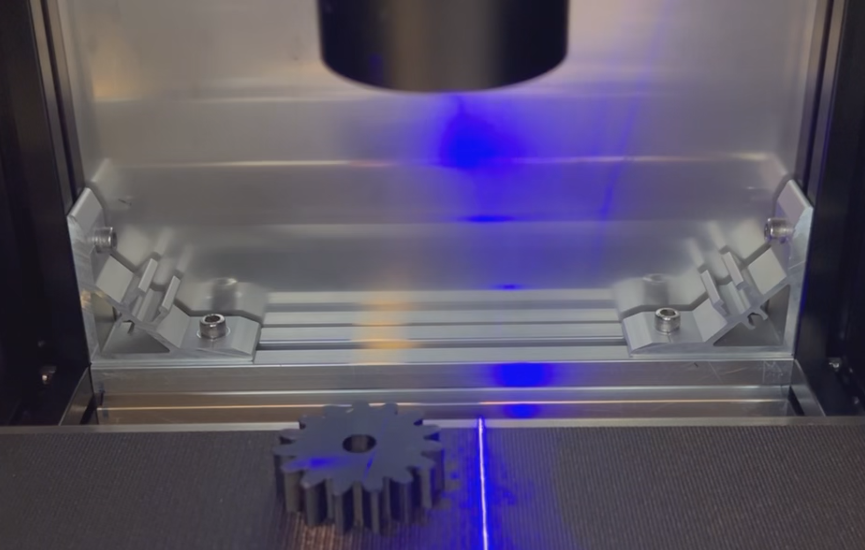
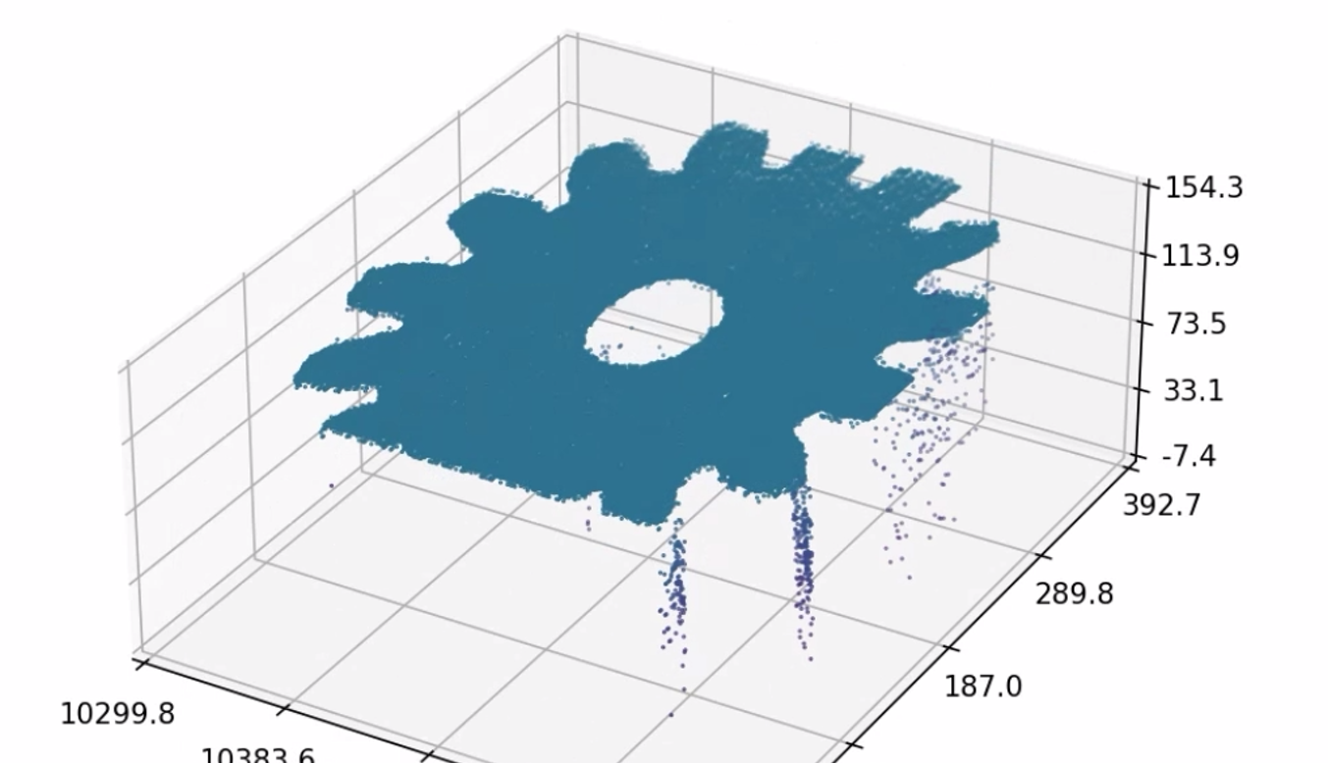
5. Result: Normal Gear
24-2 MIP Video Clip
처음에 나오고 영상 재생될 때는 사라지기
텍스트는 ‘Normal Gear’과 같이 영어로(상단에 기제 했습니당)
핸드폰
정상 기어.mp4
노트북
정상 기어.mp4
Notes:
The ultimate purpose of this project is to inspect the defect of small industrial parts. With the 3D scanning result from this system, a gear and frame was used to check the performance of detecting defect by using this system.
As you can see, each normal state of gear and frame were able to be scanned well. About the flat surfaces, this system can scan the overall shape of each parts. However, hidden sides of each objects were not scanned well, leaving the white space of 3D scanning. This limitation is the fundamental problem of the line triangulation system. Because the light is in a straight way, there must be white space of scanning.
Despite of this, the defects of each parts on the flat surfaces were scanned well. In the case of the gear, two defect were marked at on the flat surface, and these defects are reflected on the result of the 3D scanning. At the same time, the defect marked on the surface of the frame is also reflected well at the 3D scanning result.
By using this result, I could check the possibility of this system for the defect inspection about industrial small parts.

Slide 15
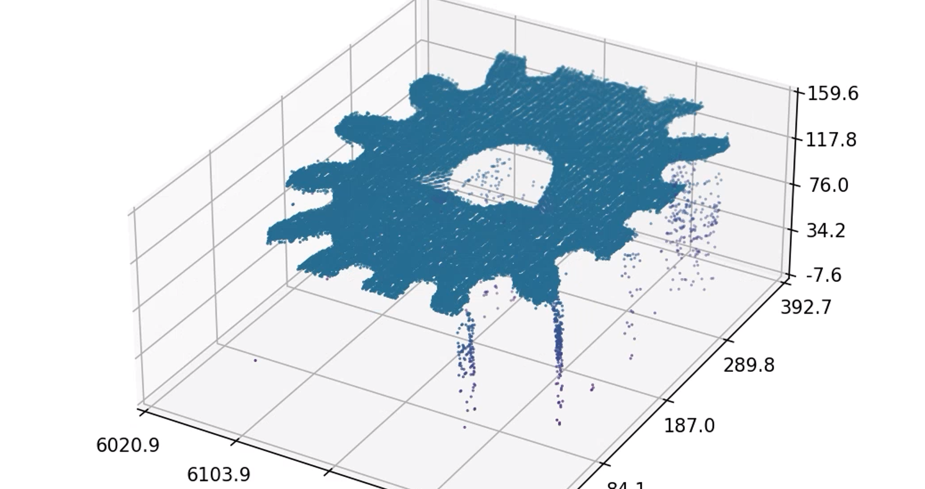
5. Result: Defective Gear
24-2 MIP Video Clip
핸드폰
불량 기어.mp4
노트북
불량 기어.mp4
Notes:
The ultimate purpose of this project is to inspect the defect of small industrial parts. With the 3D scanning result from this system, a gear and frame was used to check the performance of detecting defect by using this system.
As you can see, each normal state of gear and frame were able to be scanned well. About the flat surfaces, this system can scan the overall shape of each parts. However, hidden sides of each objects were not scanned well, leaving the white space of 3D scanning. This limitation is the fundamental problem of the line triangulation system. Because the light is in a straight way, there must be white space of scanning.
Despite of this, the defects of each parts on the flat surfaces were scanned well. In the case of the gear, two defect were marked at on the flat surface, and these defects are reflected on the result of the 3D scanning. At the same time, the defect marked on the surface of the frame is also reflected well at the 3D scanning result.
By using this result, I could check the possibility of this system for the defect inspection about industrial small parts.

Slide 16
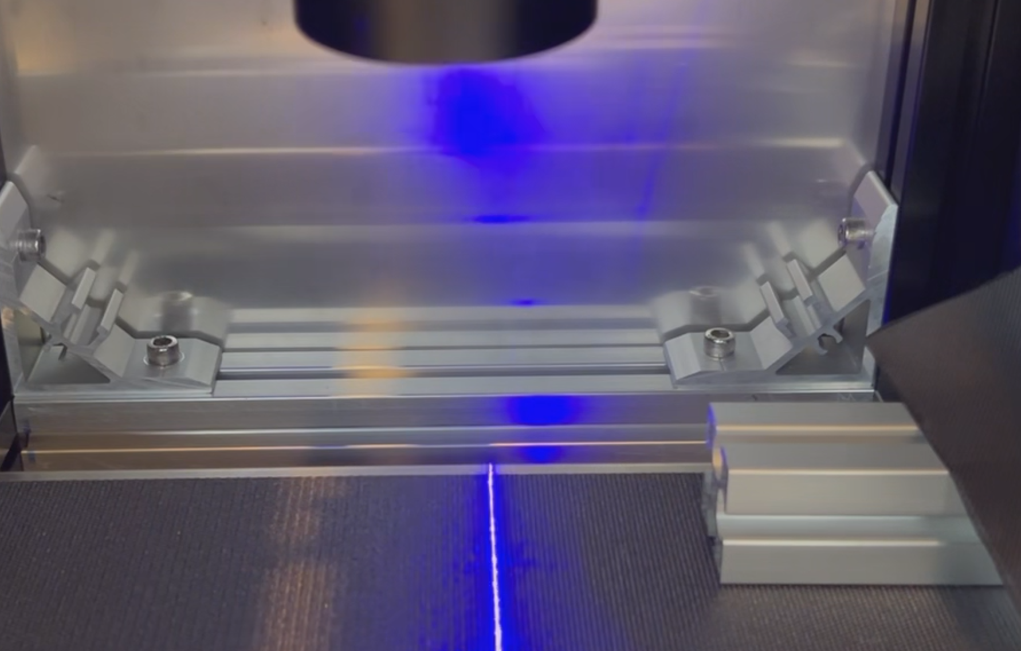
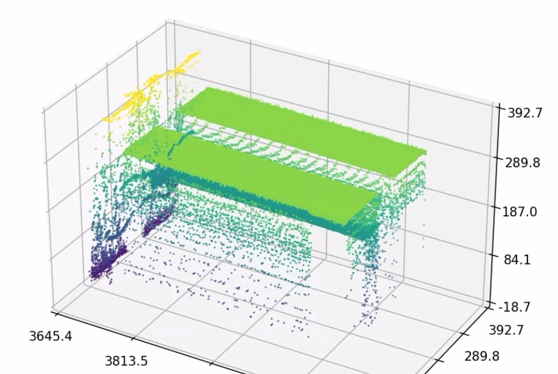
5. Result: Normal Frame
24-2 MIP Video Clip
핸드폰
정상 프레임.mp4
노트북
정상 프레임.mp4
Notes:
The ultimate purpose of this project is to inspect the defect of small industrial parts. With the 3D scanning result from this system, a gear and frame was used to check the performance of detecting defect by using this system.
As you can see, each normal state of gear and frame were able to be scanned well. About the flat surfaces, this system can scan the overall shape of each parts. However, hidden sides of each objects were not scanned well, leaving the white space of 3D scanning. This limitation is the fundamental problem of the line triangulation system. Because the light is in a straight way, there must be white space of scanning.
Despite of this, the defects of each parts on the flat surfaces were scanned well. In the case of the gear, two defect were marked at on the flat surface, and these defects are reflected on the result of the 3D scanning. At the same time, the defect marked on the surface of the frame is also reflected well at the 3D scanning result.
By using this result, I could check the possibility of this system for the defect inspection about industrial small parts.

Slide 17
5. Result: Defective Frame
24-2 MIP Video Clip
핸드폰
불량 프레임.mp4
노트북
불량 프레임.mp4
Notes:
The ultimate purpose of this project is to inspect the defect of small industrial parts. With the 3D scanning result from this system, a gear and frame was used to check the performance of detecting defect by using this system.
As you can see, each normal state of gear and frame were able to be scanned well. About the flat surfaces, this system can scan the overall shape of each parts. However, hidden sides of each objects were not scanned well, leaving the white space of 3D scanning. This limitation is the fundamental problem of the line triangulation system. Because the light is in a straight way, there must be white space of scanning.
Despite of this, the defects of each parts on the flat surfaces were scanned well. In the case of the gear, two defect were marked at on the flat surface, and these defects are reflected on the result of the 3D scanning. At the same time, the defect marked on the surface of the frame is also reflected well at the 3D scanning result.
By using this result, I could check the possibility of this system for the defect inspection about industrial small parts.

Slide 18
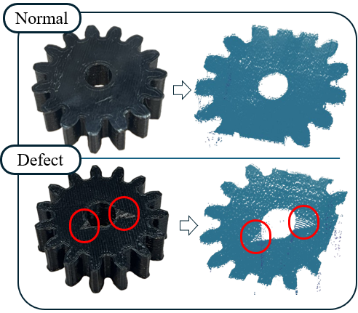
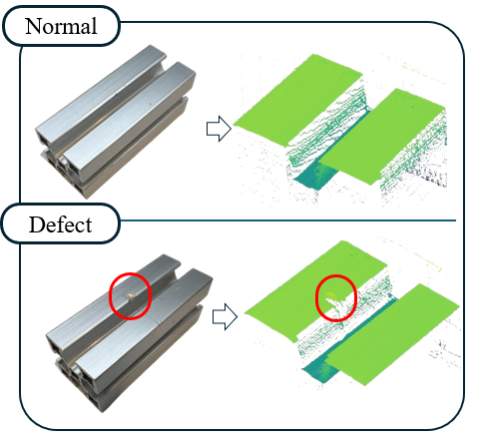
5. Result: Defect Inspection
24-2 MIP Video Clip
Overall possibility about defect inspection of this system is verified
Notes:
The ultimate purpose of this project is to inspect the defect of small industrial parts. With the 3D scanning result from this system, a gear and frame was used to check the performance of detecting defect by using this system.
As you can see, each normal state of gear and frame were able to be scanned well. About the flat surfaces, this system can scan the overall shape of each parts. However, hidden sides of each objects were not scanned well, leaving the white space of 3D scanning. This limitation is the fundamental problem of the line triangulation system. Because the light is in a straight way, there must be white space of scanning.
Despite of this, the defects of each parts on the flat surfaces were scanned well. In the case of the gear, two defect were marked at on the flat surface, and these defects are reflected on the result of the 3D scanning. At the same time, the defect marked on the surface of the frame is also reflected well at the 3D scanning result.
By using this result, I could check the possibility of this system for the defect inspection about industrial small parts.

Slide 19
Thank you
Notes:
The ultimate purpose of this project is to inspect the defect of small industrial parts. With the 3D scanning result from this system, a gear and frame was used to check the performance of detecting defect by using this system.
As you can see, each normal state of gear and frame were able to be scanned well. About the flat surfaces, this system can scan the overall shape of each parts. However, hidden sides of each objects were not scanned well, leaving the white space of 3D scanning. This limitation is the fundamental problem of the line triangulation system. Because the light is in a straight way, there must be white space of scanning.
Despite of this, the defects of each parts on the flat surfaces were scanned well. In the case of the gear, two defect were marked at on the flat surface, and these defects are reflected on the result of the 3D scanning. At the same time, the defect marked on the surface of the frame is also reflected well at the 3D scanning result.
By using this result, I could check the possibility of this system for the defect inspection about industrial small parts.

